Slide 1
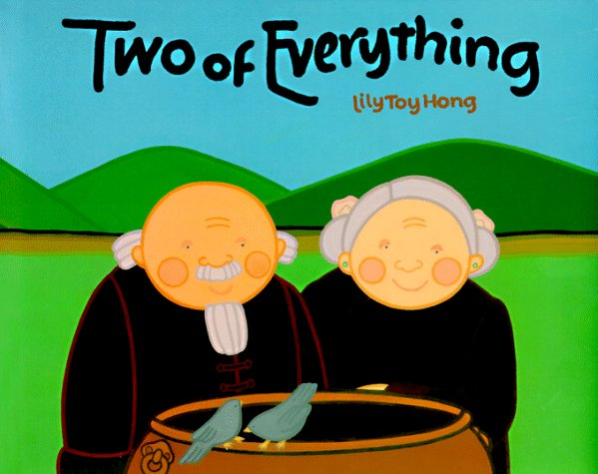
Vocabulary Review for

Slide 2
A gorilla sitting in our classroom would look very _____.
a) search
b) leaned
c) contained
d) tossed
e) startled
f) grateful
g) odd
h) village

Slide 3
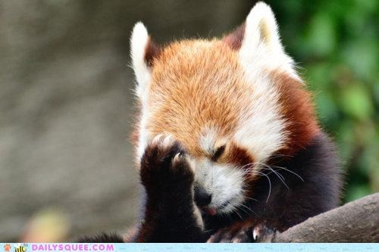
OOPS!! Try Again

Slide 4
GOOD JOB!!

Slide 5
The girl walked through the _____ to get to her friends house.
a) search
b) leaned
c) contained
d) tossed
e) startled
f) grateful
g) odd
h) village

Slide 6
GOOD JOB!!

Slide 7
I was _____ when we finally found my lost puppy.
a) search
b) leaned
c) contained
d) tossed
e) startled
f) grateful
g) odd
h) village

Slide 8
GOOD JOB!!

Slide 9
After the race, I _____ against the tree to catch by breath.
a) search
b) leaned
c) contained
d) tossed
e) startled
f) grateful
g) odd
h) village

Slide 10
GOOD JOB!!

Slide 11
She was _____ when she arrived at her surprise party.
a) search
b) leaned
c) contained
d) tossed
e) startled
f) grateful
g) odd
h) village

Slide 12
GOOD JOB!!

Slide 13
The plastic baggie _____ all the things needed to play the game.
a) search
b) leaned
c) contained
d) tossed
e) startled
f) grateful
g) odd
h) village

Slide 14
GOOD JOB!!

Slide 15
The children had to _____ for the hidden clues.
a) search
b) leaned
c) contained
d) tossed
e) startled
f) grateful
g) odd
h) village

Slide 16
GOOD JOB!!

Slide 17
The little boy _____ the ball into the basket.
a) search
b) leaned
c) contained
d) tossed
e) startled
f) grateful
g) odd
h) village

Slide 18
GOOD JOB!!

Slide 19
If you are this, you might jump or scream.
a) search
b) leaned
c) contained
d) tossed
e) startled
f) grateful
g) odd
h) village

Slide 20
GOOD JOB!!

Slide 21
Baseballs, trash, or dirty socks might have this done to them.
a) search
b) leaned
c) contained
d) tossed
e) startled
f) grateful
g) odd
h) village

Slide 22
GOOD JOB!!

Slide 23
When you play hide and seek, you do this.
a) search
b) leaned
c) contained
d) tossed
e) startled
f) grateful
g) odd
h) village

Slide 24
GOOD JOB!!

Slide 25
Characters in fairy tales might live in this place.
a) search
b) leaned
c) contained
d) tossed
e) startled
f) grateful
g) odd
h) village

Slide 26
GOOD JOB!!

Slide 27
I am always inside, never outside. What am I?
a) search
b) leaned
c) contained
d) tossed
e) startled
f) grateful
g) odd
h) village

Slide 28
GOOD JOB!!

Slide 29
A three-dollar bill would be this.
a) search
b) leaned
c) contained
d) tossed
e) startled
f) grateful
g) odd
h) village

Slide 30
GOOD JOB!!

Slide 31
Each year in November we celebrate a special day for being this.
a) search
b) leaned
c) contained
d) tossed
e) startled
f) grateful
g) odd
h) village

Slide 32
GOOD JOB!!

Slide 33
You may have done this forwards, backwards, or over.
a) search
b) leaned
c) contained
d) tossed
e) startled
f) grateful
g) odd
h) village

Slide 34
GOOD JOB!!

Slide 35
Nice Work!!
You have
mastered your Vocabulary Words!

